Slide 1
Squatm3gator:
360° Cybersquatting

Slide 2
Cybersquatting (also known as domain squatting), … , is registering, trafficking in, or using an Internet domain name with bad faith intent to profit from the goodwill of a trademark belonging to someone else.
Wikipedia

Slide 3
#whoarewe
Davide Cioccia
Stefan Petrushevski
Principal Security Researcher @ IoTsec.eu
Senior Security Engineer @ ING NL
pwnz0r1lla @ Zero Science Lab
Senior Security Engineer @ ING NL

Slide 4
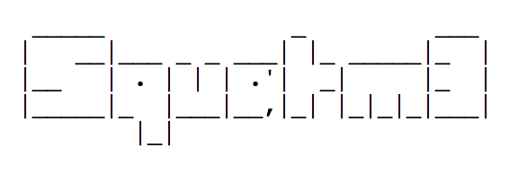

Slide 5
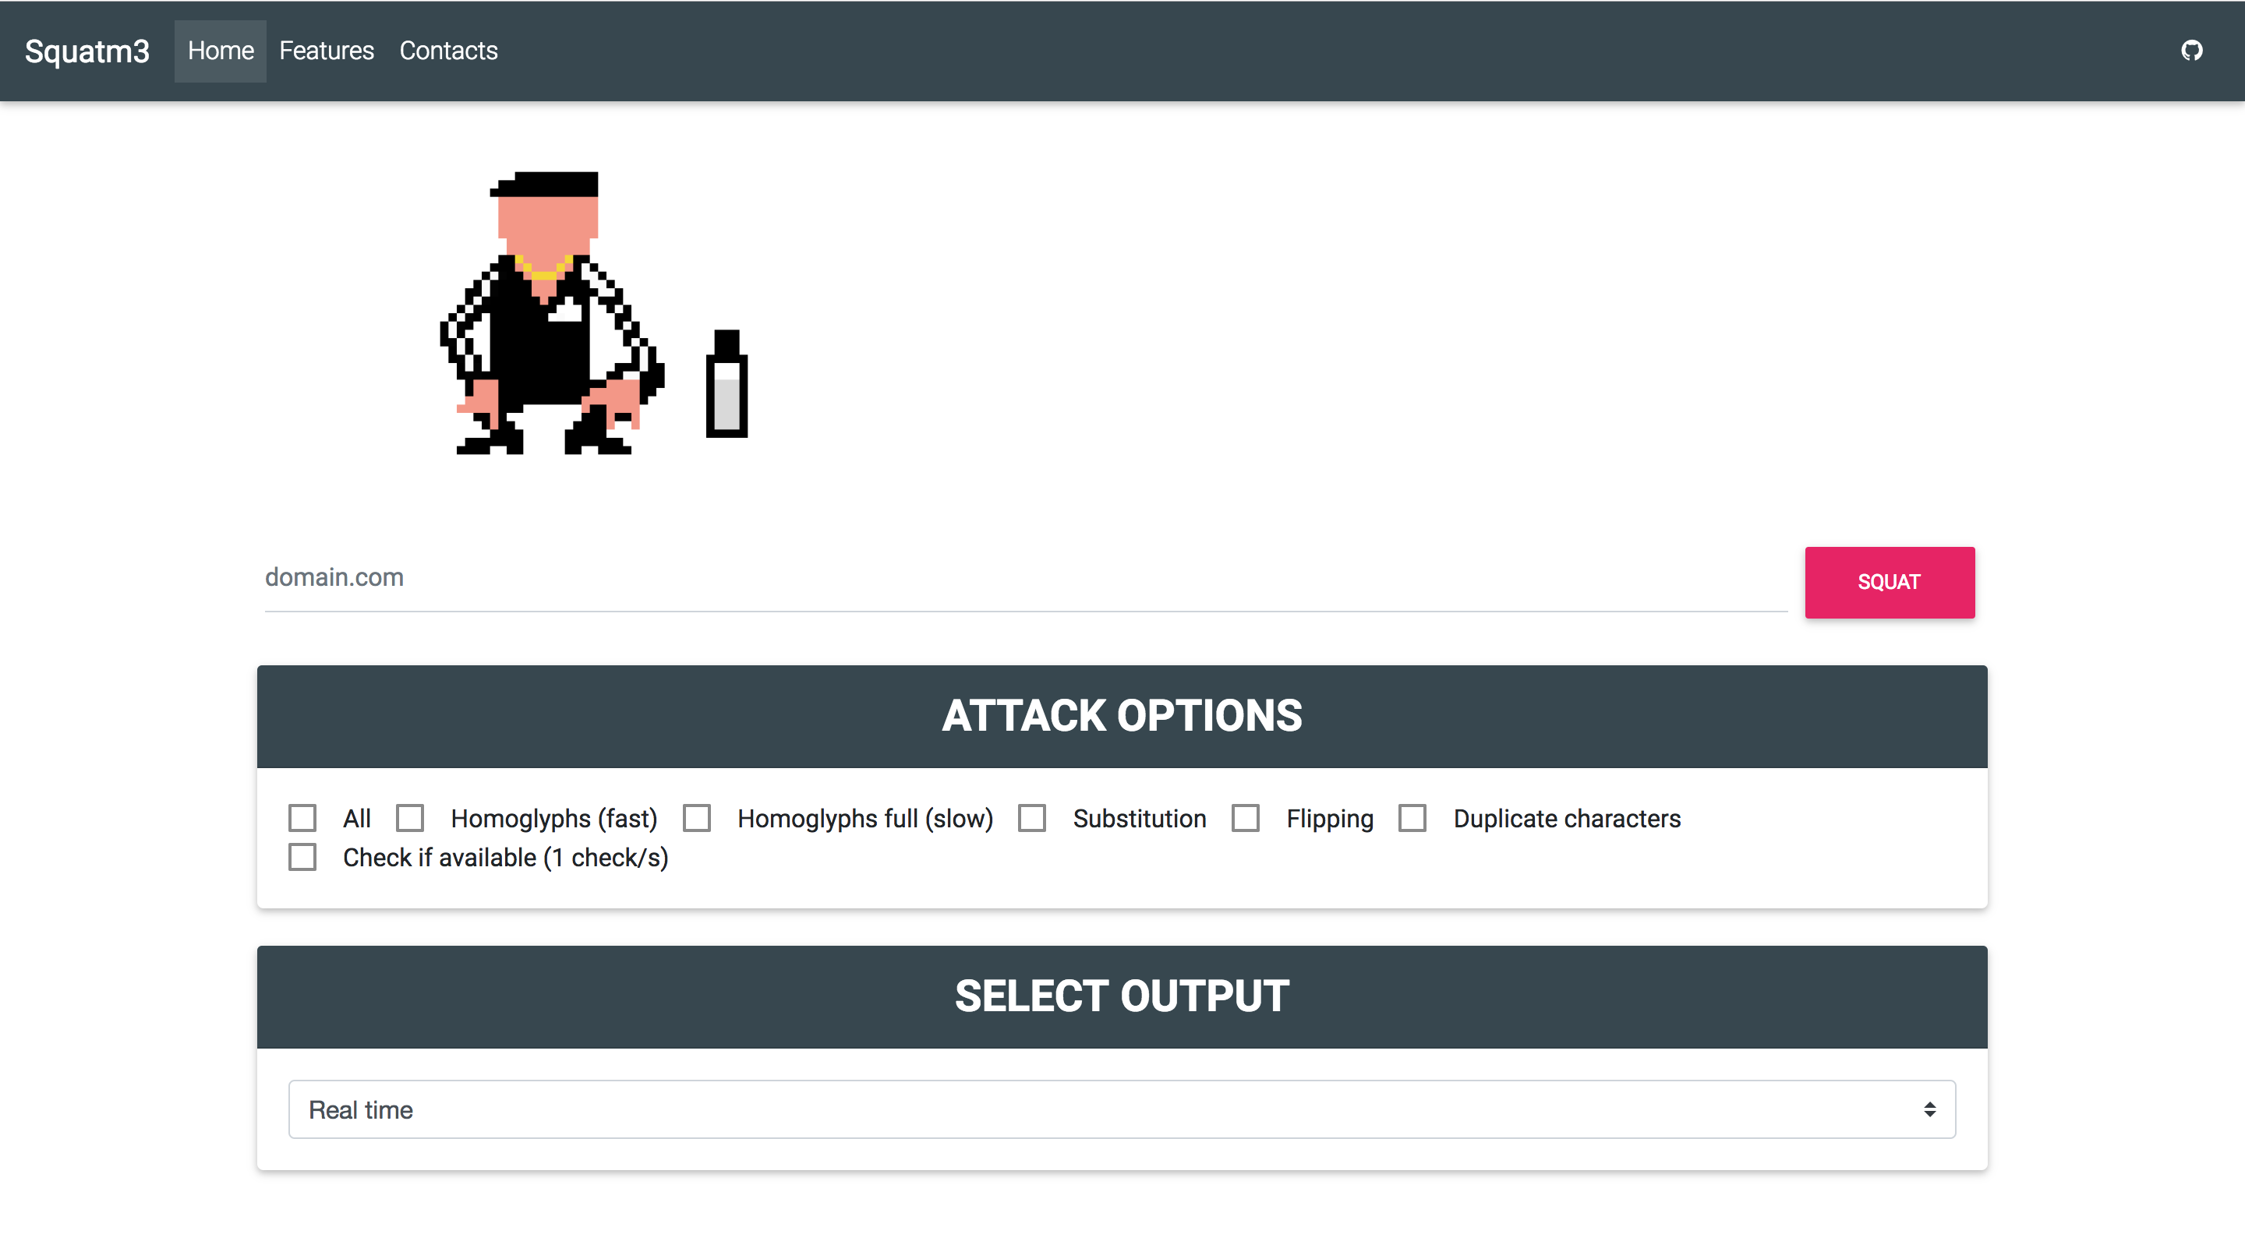

Slide 6
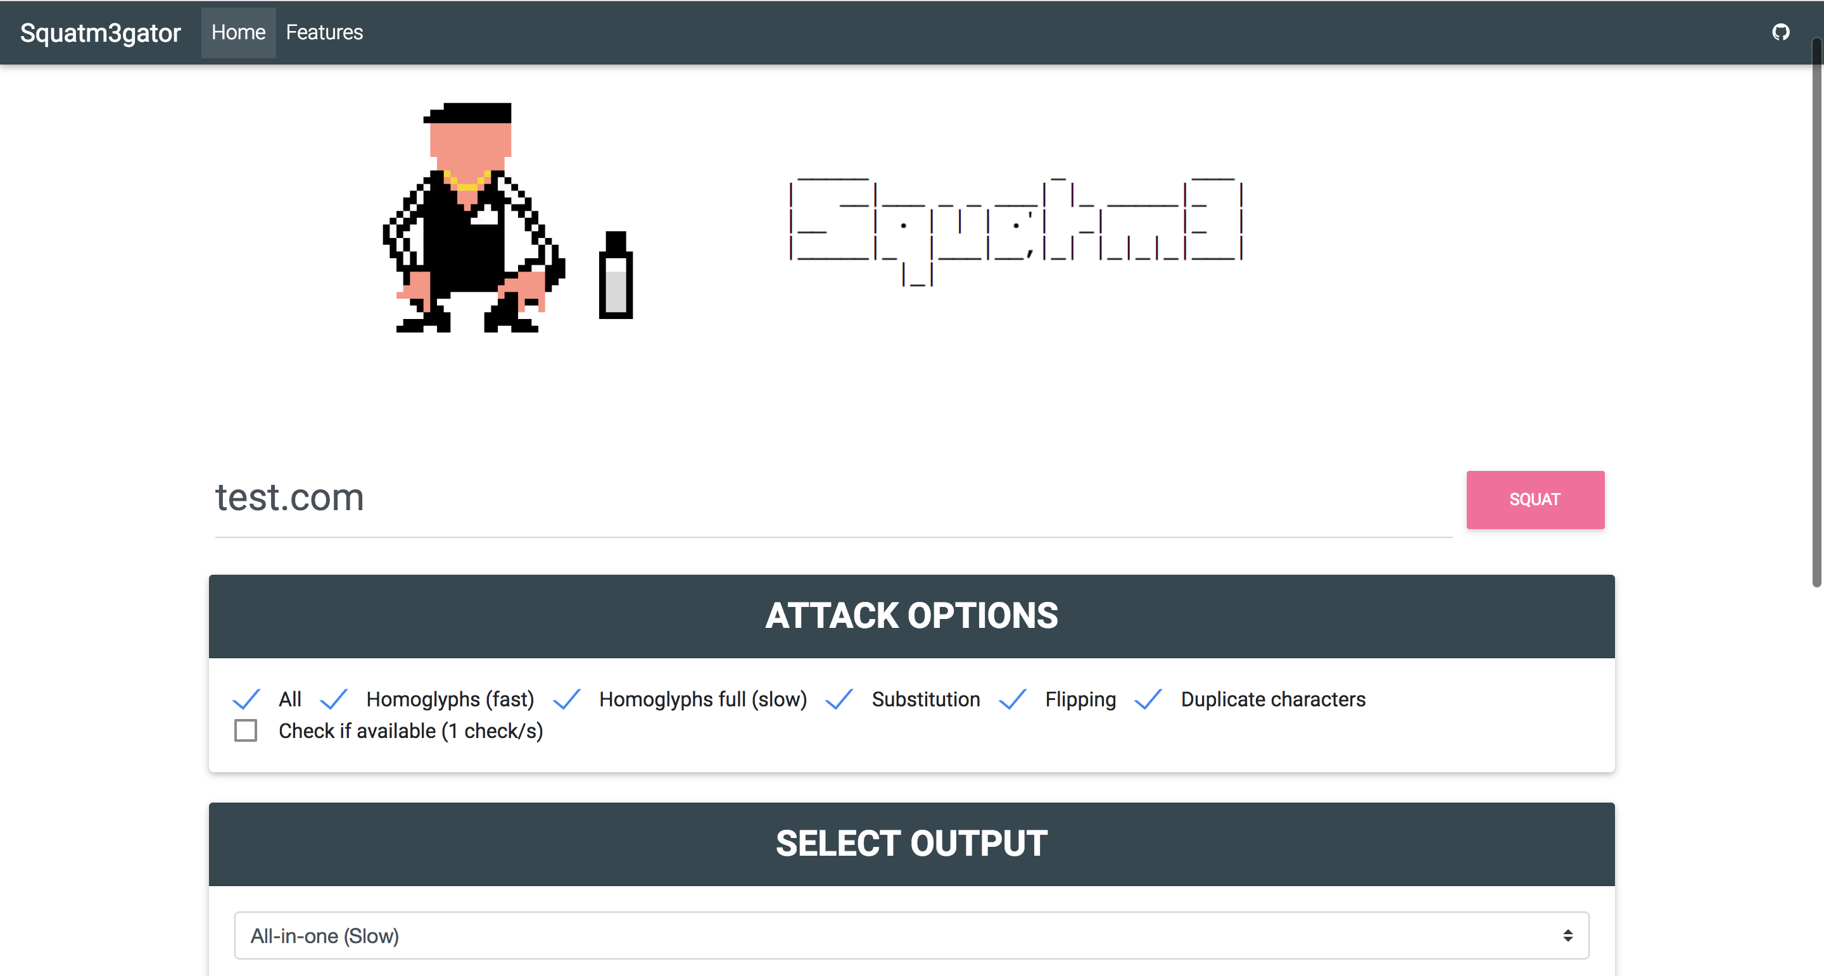
Socket.io
Workers
Redis
Squatm3
Web UI

Slide 7
RED TEAM
BLUE TEAM
Find and capture the best suitable domain for your phishing campaign
Check soon-to-expire domains and be ready to buy it
Buy and go phish
Find and capture domains that could lead to massive phishing campaigns
Monitor soon-to-expire domain
Monitor status change in available domains
Automatically detect phishing websites
Connect the output to your SIEM

Slide 8
Homoglyphs attack (one letter)
Homoglyphs attack (full)
Flipping attacks
Duplication attacks
Substitution attacks
TLD substitution
Checks on GoDaddy for available domains
JSON output for API integration
Domain information
Soon to expire domains
Complete Dockerized solution
Real time feedback on domain availability and price
Possibility to directly buy the domain
WebSockets for real time feedback
Cool UI, simple to use
Automated phishing detection

Slide 9
https://www.tesla.com/
+
+
phishing
not phishing
https://www.téslä.com/
+
+

Slide 10
Squatm3
https://github.com/david3107/squatm3
Squatm3gator
https://github.com/david3107/squatm3gator

